Slide 1
A tour of new erra
Introducing ...... The Smart Pre-Paid Meter
Notes:
This presentation demonstrates the new capabilities of PowerPoint and it is best viewed in Slide Show. These slides are designed to give you great ideas for the presentations you’ll create in PowerPoint 2010!
For more sample templates, click the File tab, and then on the New tab, click Sample Templates.

Slide 2
How does a Pre-Paid scheme works?
Vending
Smart Pre-Paid Meter
Customer
Currency & Meter
System information

Slide 3
The Principle : The SYSTEM: The Meter
A System that Supports An Effective & Trust Worthy Revenue Collection.
A System that Prevents Any Kind of Out-Standing.
A System that is More Dynamic & Digitally Enhanced.
A System that Provides Customer Care with Lots of Freedom.
A System that Brings a Leap in Energy Calculation in Accuracy.
A System that Prevails from Human Hauled Operation that is Costly and rather Slow.
A System that Align the Customer to be Optimal in Their Load Demand.
A System that is Fully Digital as it is Free from All Kinds of Demerits of the Aged Old Running System
A System that Eliminates All Kinds of Confusion.
A System that is Free from Any Havoc of Corruption.

Slide 4
The basic Principle of Prepayment is to buy Energy in advance and inform the meter in some ways
The credit stored is deducted as per energy usages and the meter will cut the output line as the credit reaches zero.
If the consumers buy more credit and recharges, he can enjoy energy usage without discontinuity
Vending Station with online payment system are used to sell credit to the consumers
No Due will be generated.
Easy to add credit to the meter
Warning for low credit
Negative credit during Friendly hours/Holidays
Emergency credit
Data exchange between meter and the utility
Tamper protection
Abnormal voltage protection
Non-allowance of over sanctioned load
Automated record keeping
No outstanding
Advance collection of bills
No need for meter reader and billing
Reduce down the confusion in between the house owner and the tenant as well as with the Utility people.

Slide 5
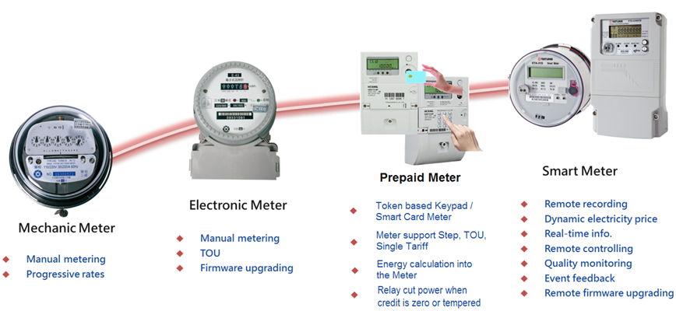
The Journey

Slide 6
Fundamental Functions for Smart Metering
The following functions are minimum for smart metering.
Remote data collection: Collection using two-way communication
Tampering detection, Event detection
Outage monitoring, Power quality monitoring
Disconnection/Reconnection, Load limiting
Load Profile, Time Of Use
Time synchronization
Firmware upgrade

Slide 7
Advanced Metering Infrastructure (AMI)
The AMI is the nerve center of any smart grid implementation.
AMI is a data rapid transportation network encompassing the source and destination entities.
The goal of AMI is to provide electricity supply companies with the real time data about power consumption and allow customers to make informed choices about energy usage based on the price at the time of use.

Slide 8
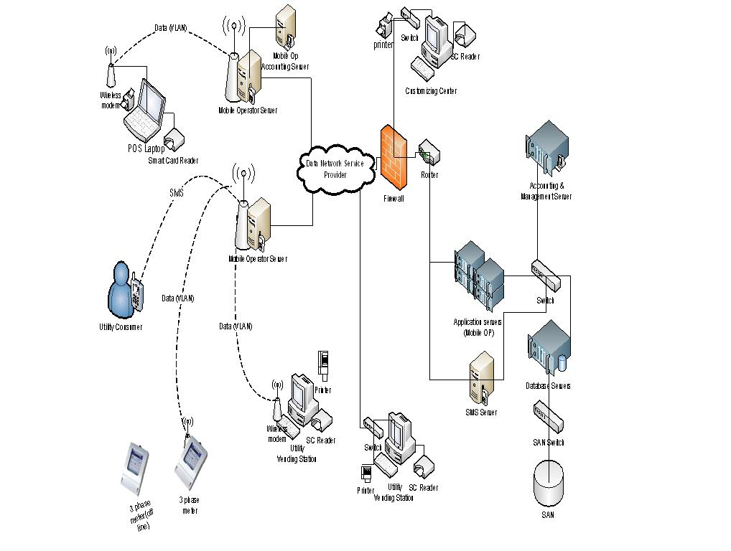
The Basic Network Diagram
Overall Network System

Slide 9
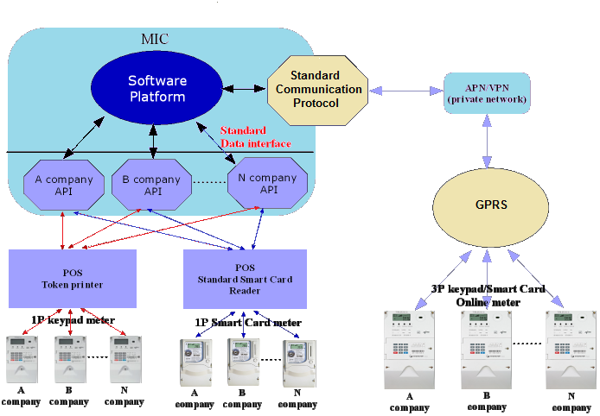
Multi-Manufacturer Vending Architecture of Unified Prepaid System

Slide 10

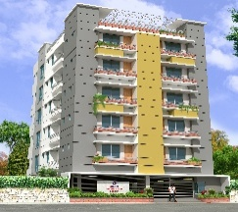




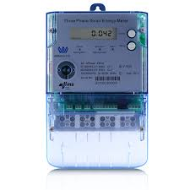
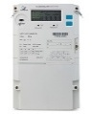
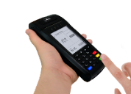

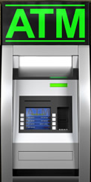
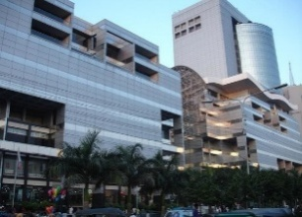
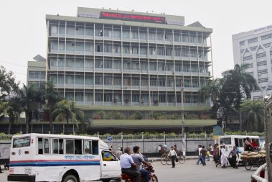
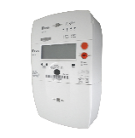
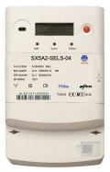




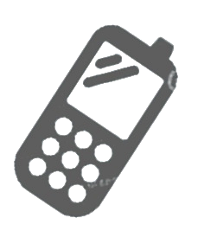
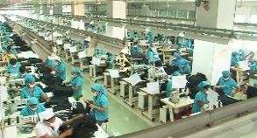



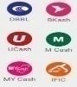
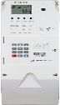
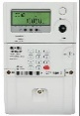


Best Practice in Unified Prepaid System
Internet/Intranet
VPN/APN
Residential Customer
Mobile
Operator
Smart Unified Prepaid Metering System
3rd Party
Vending
Commercial Customer
Utility Vending
Industrial Customer
Vending Options
Mobile Banking
Agent

Slide 11


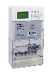
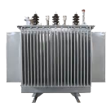
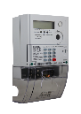
Solution
Smart Prepayment Solution
Application
Unified System
Billing
MDM
CIM
Data Collection
Standard Multi Vendor HES
Communication
Smart Meter
GPRS
DC
BPLC
RF
Notes:
CIM:IEC61968,IEC61970
Unified System can easily be extended with different module and interface with others system.

Slide 12
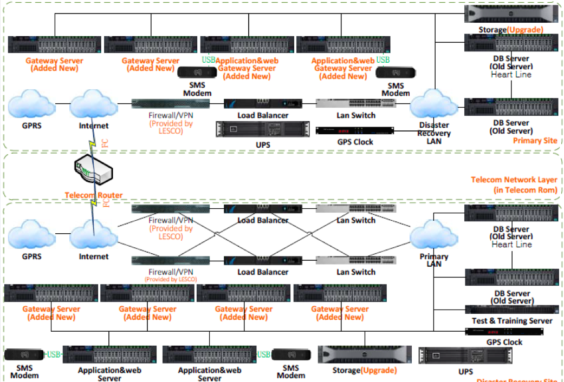
Smart Prepayment Topology-Hardware
Unified System
IT structure
Database
Application Server
Notes:
CIM:IEC61968,IEC61970

Slide 13

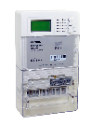
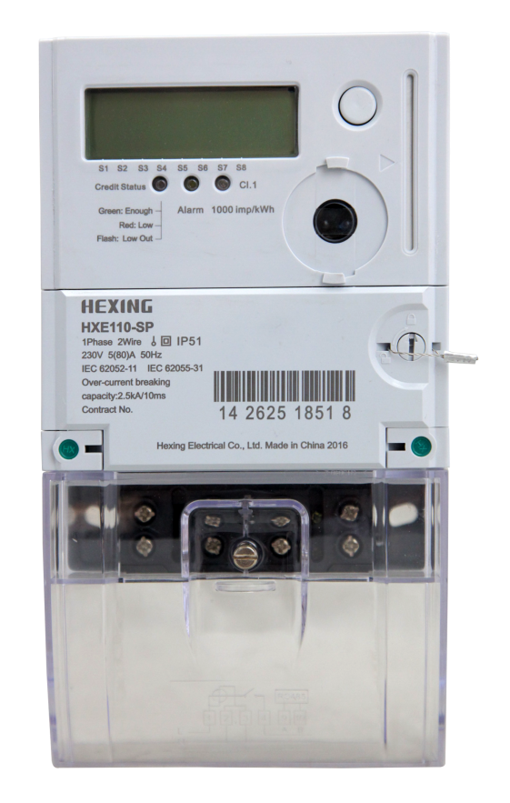
Smart Prepayment Topology-System Architecture Smplified
MDMS
Unified System
HES
Vending Service
Tariff Management
3rd Party Vending Interface
Tax Management
CDU Management
CIM Interface
Meter Maintenance
Report
Meter Reading
Event & Alarm
CIM Interface
Gateway
Load Control
Time Synchronization
Communication Service
Firmware Upgrade
Report
GPRS

Slide 14
Smart Prepayment Topology-
Third Party Vending

Slide 15
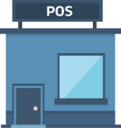
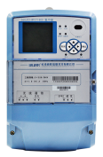


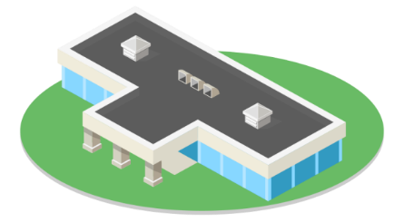
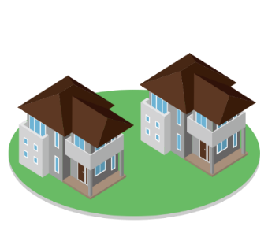

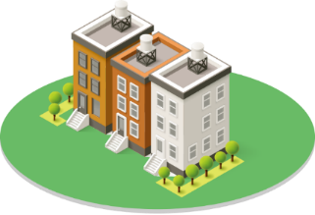
Smart Prepaid Meter Total Solution
MDM
Vending System
GPRS/3G
Network
HES
3rd Party Vending Server
POS
GPRS/Ethernet
GPRS/Ethernet
GPRS/3G
Smart 3P Prepaid Meter
RF Data Concentrator
PLC Data Concentrator
GPRS/Ethernet
ATM
RS485
RF
PLC
Third Party System
Smart 3P Prepaid Meter
Smart 1P Prepaid Meter
Smart 1P Prepaid Meter
Smart 1P Prepaid Meter
Mobile APPS
Commercial & Industrial Area
Village
Residential Area
Residential Area

Slide 16
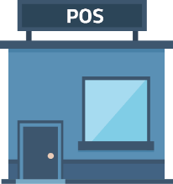


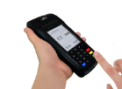



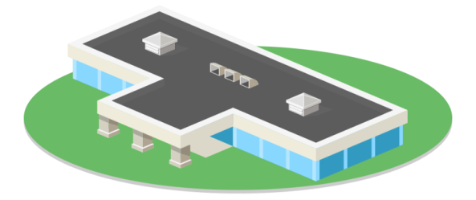

Smart Metering System with existing Unified Prepaid System
Unified Prepaid System
GPRS/3G
Network
3rd Party Vending Server
POS
UVS
Vending
Bank
Vending
GPRS
GPRS/3G
POS
GPRS Solution
PLC/RF Solution
ATM
PLC/RF
DCU
DCU
Third Party System
Smart 3P Keypad Prepaid Meter
Smart 1P Card/Keypad Meter
Smart 1P Keypad Meter
Smart 3P Keypad Meter
Mobile POS
Commercial & Industrial Area
Rural Area
Commercial & Industrial Area
Residential Area

Slide 17
A tour of new erra
Introducing ...... The Communication Module
Notes:
This presentation demonstrates the new capabilities of PowerPoint and it is best viewed in Slide Show. These slides are designed to give you great ideas for the presentations you’ll create in PowerPoint 2010!
For more sample templates, click the File tab, and then on the New tab, click Sample Templates.

Slide 18
Objectives for Smart Pre-Paid Metering System
The objectives of these approaches are:
To increase customer services; and
To improve performance of the utilities.
To select appropriate communication technology
To develop smart and safe network to support two way communications;
To strengthen the security;

Slide 19
The Scopes
The scopes of services on the Smart Metering Communication
Study of the existing pre-paid metering system of the utilities in Bangladesh;
available communication technologies/medium and its availability of the components of the smart metering/prepaid metering system;
Advantages and disadvantages of different components of communication technologies/mediums;
Cost comparison of different communication technologies for efficient system developments;
Give example of different communication technologies that are being used successfully around the globe considering rural and urban areas.
Recommend appropriate communication technology/technologies for distribution entities considering operation area and service arrangement, geographic location, consumer pattern, technical facilities etc.;
Prepare list material that will be required for the proposed communication technologies along with detail specification of all devices including estimated cost as on the goal arrowing the reduce buden and increase the futuristic facts;
Suggest on possible cyber risks and security, licensing of relevant software’s, replacement/up gradation of communication devices, data communication and storage, O/M of the communication system etc.;
Constant eye on regarding communication technology of Smart Pre-Paid Metering System.

Slide 20
The Architecture
Collector
The collector, also known as data concentrator, concentrator or gateway serves as communication node for the HES.
Its primary function is to interface between the HES and the meters within its the neighborhood area network (NAN).
Meter
The meter is installed at consumer premises.
When integrated with a collector,
The Collector directly communicates to the HES.
As a meter it either communicates with the collector
or may serve as a relay in order to route packets between nearby meters and the collector.
The meter can directly communicates to the HES.
Communication
The infrastructure consist of several networks
of which all could rely on absolutely different media and a multitude of protocols.
In total, three networks are commonly described when referring to the AMI. The WAN, NAN and HAN.

Slide 21
The Architecture
Wide Area Network (WAN)
The WAN does connect a meter or collector to the HES.
The WAN is sometimes also referred to as the backhaul network.
Communication on the WAN link is mostly Internet protocol (IP) based and does commonly rely on standard information technology (IT) media
and technology stacks such as fiber optic cables (FOC), digital subscriber line (DSL), general packet radio service (GPRS), multi-protocol label switching (MPLS), or some sort of private network
That can be wired and wireless in both combined depending on the architecture.
Neighborhood Area Network (NAN)
The NAN connects meters and collectors.
Typical NAN devices are electricity, gas, water or heat meters.
Organizations sometimes refer to the NAN as local area network (LAN), or field area network (FAN).

Slide 22
Smart Metering Standardization Framework
IEC 62056 DLMS/COSEM series of standards specifying electricity meter data exchange.

Slide 23
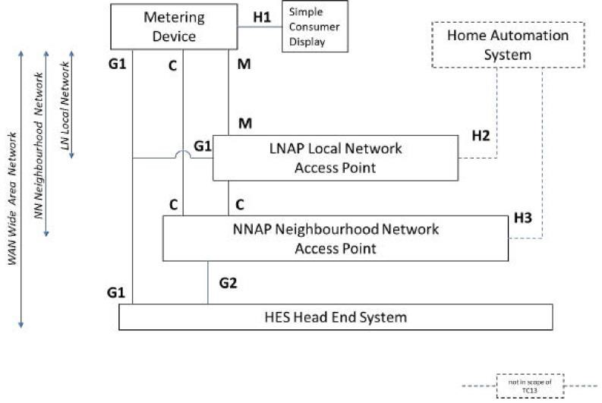

Slide 24
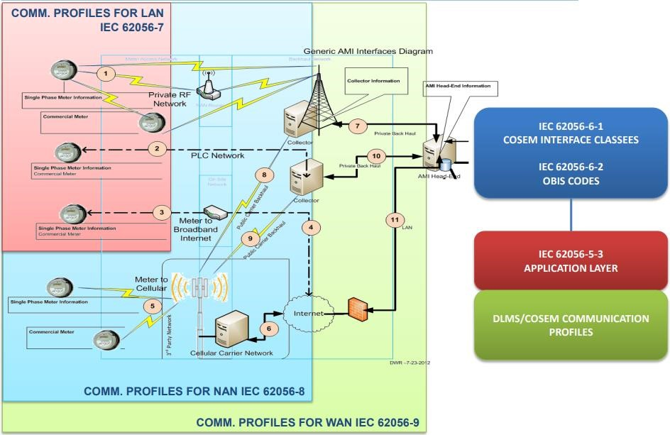

Slide 25
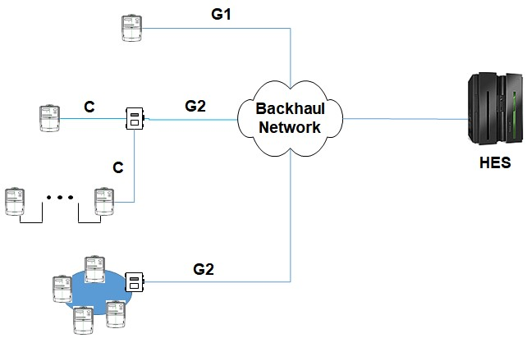
Interface between the devices and corresponding communication media, which is common in actual AMI implementation, can be summarized below but not exhaustive:
Components | Interface | Comm. Media
MD <–> LNAP | M | RS-232, RS-485
MD< –> HES | G1 | 2G/3G/4G, fiber/xDSL
LNAP <–> NNAP | C | RF, PLC
NNAP< –> HES | G2 | 2G/3G/4G, fiber/xDSL
MD₁ … MD_{n} – LNAP | n/a | MD₁ … MD_{n}: M (in general RS-485) MD_{n} – LNAP: M, G1

Slide 26
Repeater
• It shall be possible to install/replace/remove from distribution lines without special tools.
• It shall be powered directly from distribution lines.
• It shall support 3 phase connection, but shall be able to operate with any single phase of the 3 phase.
• It shall be able to be installed at power poll as well as on wall.
• It shall support IP65. Use of external enclosure that meets the IP degree is
acceptable. In the latter case, the dimension shall be less than 400 x 300 x 150 (H x W x D, in mm).
Data Concentrator
• It shall be powered directly from distribution lines.
• It shall support 3 phase connection, but shall be able to operate with any single phase of the 3 phase.
• It shall be able to decide the phase of connected single-phase smart meters.
• It shall be able to be installed at power poll as well as on wall.
• It shall support IP65. Use of external enclosure that meets the IP degree is acceptable. In the latter case, the dimension shall be less than 600 x 400 x 150 (H x W x D, in mm).
• It shall support auto discovery of meters under its own distribution transformer.
• It shall be able to support at least 500 meters.
• It shall store metering data for at least three months for 100 meters.
• It shall store alarm/event for at least five months for 100 meters.

Slide 27
• It shall be log operation history for at least one month for 100 meters.
• It shall support “last gasp” and outage notification, and shall be operate at least 6 hours during power outage for communication with Head End System. During the operation, there is no need to communicate with smart meters under its own distribution transformer.
• It shall support SNMP v2 and web server.
• It shall provide network topology for connected meters.
• It shall support signal level for connected meters.
• It shall support IPSec VPN.

Slide 28
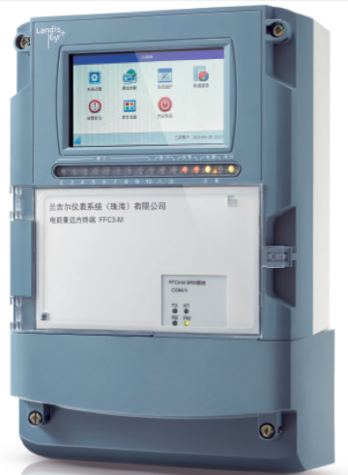
DEVICES
Gateway
SPECFICATION
Combined Structure (Power Monitoring + Data Concentration + Distribution Transformer Monitoring + Controlling) “ depends on type”
Outdoor (IP65) & Indoor Installation
Variety of Uplink and Downlink Communication Channels (GPRS/3G/4G/Ethernet + USB/RS485/RF/BPLC/WiFi)
Supporting more than 1200 MP

Slide 29
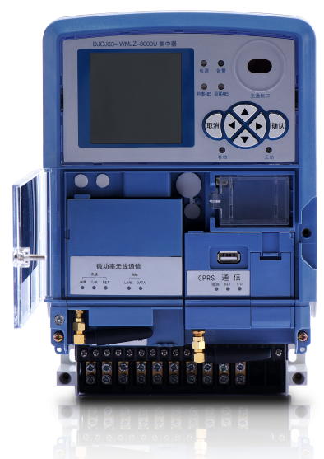
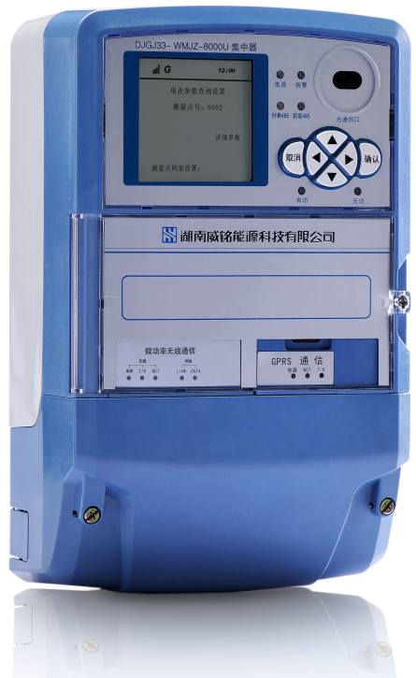
Data Concentrator - Outlook
Down Link:
Up Link:
GPRS/Ethernet Module

Slide 30
Data Concentrator Unit Technical Specifications
Sr. No. | Item | Requirements
1 | Industrial Communication Protocol | IEC62056
2 | Wireless Uplink | 3G/GPRS
3 | Fixed Ethernet Interface | 1* GE/1*GE Combo
4 | Downlink: Broadband PLC/RF | Broadband PLC/433M/915M RF
5 | DI/DO Interface | 2-channel DI/2-channel DO
6 | Fixed Interface | RS485*2
7 | Other interface | 1 Pulse out,1 Infrared, 6 Operation Keys,
8 | USB 2.0 | 1
9 | Serial Console Interface | 1
10 | Memory | 256 MB
11 | Flash | 512 MB
12 | Remote firmware upgrading | Support upgrade software package stored locally, and dispatch the package to all connected meters by multicast. Support OTA (Over the Air) technology
13 | Last Gasp | When power off, the concentrator will send the alarm to Master Station.
14 | White List | Adds smart meters to the white list for management. The white list prevents communication crosstalk among concentrators in the same transformer area and illegal smart meter access.
15 | Maximum Power Consumption | 12.5 W
16 | Power Frequency | 50/60 Hz
17 | Operating Temperature | -25℃ to +70℃
18 | Storage Temperature | -40℃ to +85℃
19 | Relative Humidity | 5% RH to 95% RH

Slide 31
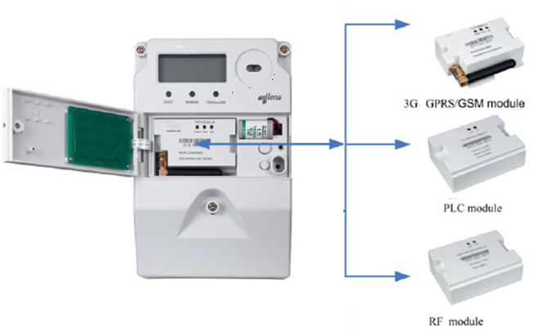
Three types of plugin Communication Module options are available for Smart Meter

Slide 32
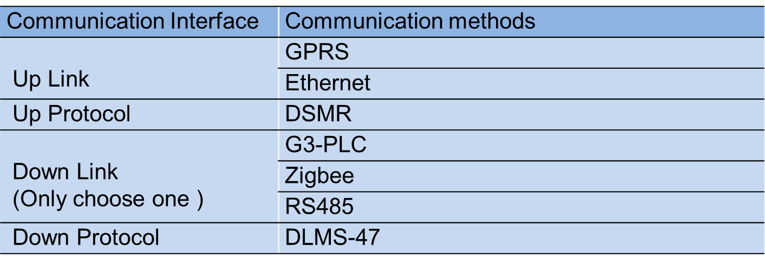

Slide 33
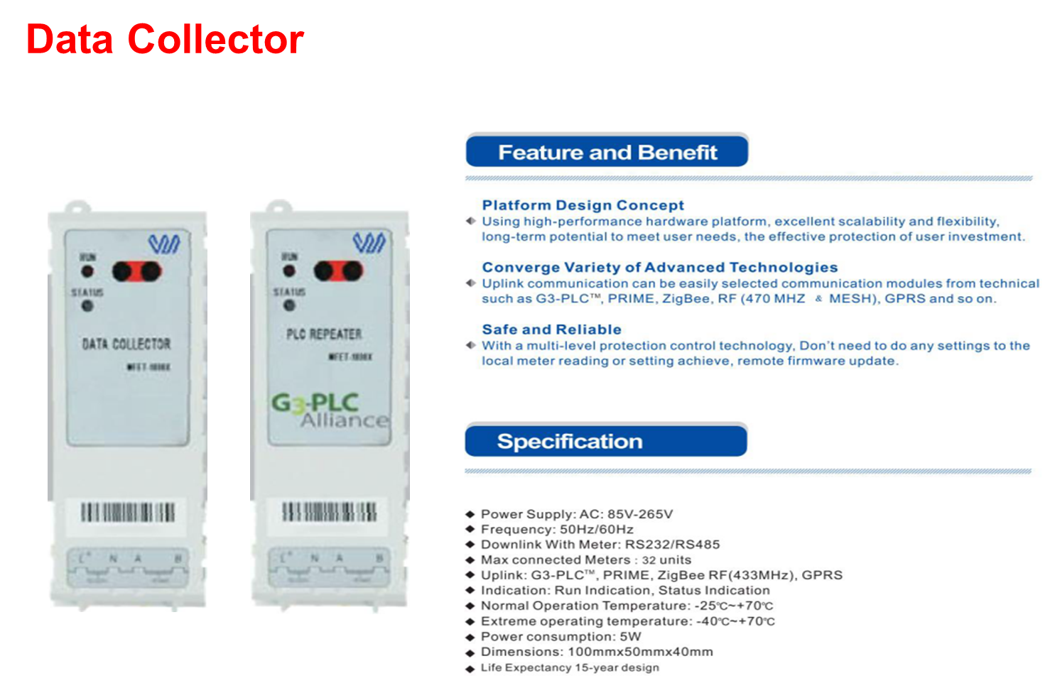

Slide 36
In large, Communication can be divided into two categories: Wired and Wireless.

Slide 37
Wired

Slide 38
Wired Technologies
There are many different wired communication technologies. Among them the followings are in the most common.
PLC,
Digital Subscriber Line (DSL) and
Fiber Optic
There are two types of PLC, as they are as follows:
Narrowband PLC (NB-PLC)
Broadband PLC (BB-PLC)
Narrowband PLC (NB-PLC)
Narrowband PLC (NB-PLC) technology implies on
data is transmitted through a narrow frequency band at a low bit rate.
NB-PLC technologies aim at offering indoor (home automation) and outdoor (smart grid) command and control services.
One application of NB-PLC is the control and telemetry of electrical equipment such as meters, switches and heaters.
NB-PLC is usually applied for the telecommunication link between the smart meter and data concentrator.
In Europe the NB-PLC band goes roughly from 3 kHz to 150 kHz and is further divided into four sub-bands. More specifically,
the CENELEC A band (3–95 kHz) is mostly used by power utilities for applications like monitoring or controlling the low-voltage and distribution network.
CENELEC B-band (95–125 kHz) can be used for any kind of applications,
the C-band (125–140 kHz) for home networking systems
the CENELEC D-band (140–148.5 kHz) is specified for alarm-and security systems.
In Japan, ARIB has specified the 10–450 kHz frequency band for PLC applications, whereas
in USA FCC has defined the 10–490 kHz frequency band for this purpose.

Slide 39
NB-PLC is usually applied for
the telecommunication link between the smart meter and data concentrator,
its efficiency depends on
the specific PLC technology used and
the quality/age of the existing power network in combination with
the demography of the power network.
NB-PLC provides best performance in clean energy networks.
Difficulties:
it is hard to quantify the NB-PLC in an urban/industrial mixed environment where appliances are often more aged and not necessarily regulated
the more regulated environments (such as seen in Europe).
the technology relies on availability of power on the network for the transmission of data,
during an outage it is not possible for the meters to send last gaps messages to the AMI management systems.
The absence of the actual message from the meter impacts how and conclusions can be drawn during an outage.

Slide 40
Two Orthogonal Frequency Division Multiplexing (OFDM)-based NB-PLC solutions that can offer high data rates,
PRIME and
G3-PLC
Both PRIME and G3-PLC use the (OFDM) transmission method and the DBPSK/DQPSK modulation technique.
The difference is that
in PRIME the DPSK concept is used in the frequency domain and the encoding process, whereas
in G3-PLC in the time domain and the encoding process.
The encoding process:
• IEEE 1901.2: It is a high data rate standard and it defines NB-PLC both via alternating and direct current. Smart Grid applications are included. Other PLC technologies operating below 500 kHz can also coexist. It is noteworthy that the standard includes three physical and MAC layer specifications, the G3-PLC (10– 500 kHz), the G3-PLC for CENELEC A and the PRIME for CENELEC.
For Smart Grid:
• ITU-T G.hnem: This standard can be used for a variety of Smart Grid applications such as smart metering, demand response, etc. It is a high data rate standard and uses the OFDM technology that refers to in-home energy management and home automation. It should be noted, that in this standard, the recommendations ITU-T G.9902, ITU-T G.9903, ITU-T G.9904 are included, which contain the physical and data link layer specifications for ITU-T G.9902, G3-PLC and PRIME NB-PLC OFDM transceivers respectively.
• IEC 61334: Part 5 of this standard defines NB-PLC systems, whereas part 5-1 defines in particular an S-FSK scheme (G1 specification). Single carrier technologies are used, meaning that the data rate is low. The data concentrator in such a system acts as a “local relay” for a management center.
the Binary PhaseShift Keying (BPSK) modulation
There is another technology that is also popular for smart meter applications when it comes to the data transmission from the smart meter to the data concentrator, namely Meters and More. According to it the physical layer is designed by using the Binary PhaseShift Keying (BPSK) modulation, while the LLC layer is based on IEC 61334-4-3. This technology is optimum for the transmission of very short messages, but the data rate is only 1200 bps (@50 Hz) and 2400 bps (@60 Hz).
While NB-PLC is usually applied for the telecommunication link between the smart meter and data concentrator, its efficiency depends on the specific PLC technology used and the quality/age of the existing power network in combination with the demography of the power network. NB-PLC provides best performance in clean energy networks. While it is hard to quantify the NB-PLC in an urban/industrial mixed environment where appliances are often more aged and not necessarily regulated (e.g. for EMC) tend to have lesser overall performance then the more regulated environments such as seen in Europe. It should further be noted that due to the fact the technology relies on availability of power on the network for the transmission of data, as a result of this during an outage it is not possible for the meters to send last gaps messages to the AMI management systems. The absence of the actual message from the meter impacts how and conclusions can be drawn during an outage.

Slide 41
NB-PLC Requirements
General
• PLC equipment shall be G3-PLC product certified for FCC band. If not certified yet, certification shall be submitted before 2 (two) weeks of Factory Acceptance Test. Platform certificate is not acceptable.
• It shall support two-way communication.
• It shall support over the air firmware upgrade.
• It shall support time synchronization.
Communication module for smart meter
• It shall be field replaceable.
• It shall be plug-and-play.
• It shall support auto registration.
• It shall support auto routing
• It shall be powered by meter itself.
• It should be possible to retrieve mesh topology.
• It should be possible to communicate with the meters directly using DLMS/COSEM and CoAP.
• It should be possible both to unicast (upgrade one meter node) and multicast (upgrade a group of meter nodes simultaneously) using software and common configurations.

Slide 42
Example on: NB-PLC
The Detail on NB-PLC example on G3-PLC

Slide 43
Broadband PLC (BB-PLC)
The concept of BB-PLC was initiated with the scope of providing
In Smart Metering Field
To use Internet access applications
To use BB-PLC for the last-mile communications and for home networking.
To use BB-PLC devices offer bit rate in the order of hundreds of Mbit/s and they do not need new infrastructure.
The frequency band of operation is between 2 and 30 MHz.
The Open PLC European Research Alliance (OPERA) project aimed at offering broadband access service by exploiting the B-PLC technology.
Although the broadband scenario has been widely used for in-home applications and Internet access, it has not experienced major deployment when it comes to smart metering applications. However, there are some examples where the BB-PLC is used for smart metering and in general for smart grid applications.
Among the project objectives were:
to improve both the LV and the MV PLC system in terms of
bandwidth,
distances reached and
network management.
Three types of devices are defined, namely
the Head-End (HEs),
the Repeaters and
the Customer Premises Equipment (CPE) like AMI based Smart Prepaid Meter.
These devices form a multi-hop system.
As a first step, industrial specifications were made available for BB-PLC. The most popular ones are the HomePlug 1.0 allowing data rates of 14 Mbps and the HomePlug Turbo allowing for data rates of 85 Mbps. Higher data rates at the scale of 200 Mbps were defined by the HomePlug AV, the UPA and the HD-PLC specifications. The equivalent industry alliances are the HomePlug Powerline Alliance, the Universal Powerline Association (UPA) and the High Definition Power Line Communication (HD-PLC). Afterwards,

Slide 44
The standards for BB-PLC followed, namely:
• TIA-1113: It is based on HomePlug 1.0 specification and defines a data rate of 14 Mbps. The Physical layer is based on OFDM while the MAC is based on the CSMA/CA (Carrier Sense Multiple Access with Collision Avoidance) scheme.
• IEEE 1901: It defines a speed at the rate of 100 Mbps and is based on the HomePlug and the HD-PLC alliance specifications. The Physical and MAC layer are defined by two technologies, the FFT-based OFDM and the wavelet-based OFDM. By this way, compatibility is assured for devices using the two different aforementioned specifications (HomePlug and HD-PLC).
• ITU-T G.hn: This standard gives a high data transfer rate reaching up to 1 Gbps and it refers to Home Networking.

Slide 45
Broad Band PLC Technical Specifications
Sr. No. | Item | Requirements
1 | Communication Method | Broadband PLC
2 | Standard | IEC 62056
3 | Modulation Mode | OFDM
4 | Frequency | >500KHz
5 | Communication Distance | Max.3000m
6 | Average. Distance | min. 200m
7 | Data encryption for PLC | Support AES,3DES,DES for data encryption and decryption
8 | Phase Identification | Support
9 | Communication Repeat | 15
10 | Hot Plugging | Support
11 | Band Width | >1Mbps
12 | Daily meter success rate | 100%
13 | Subcarrier | >100

Slide 46
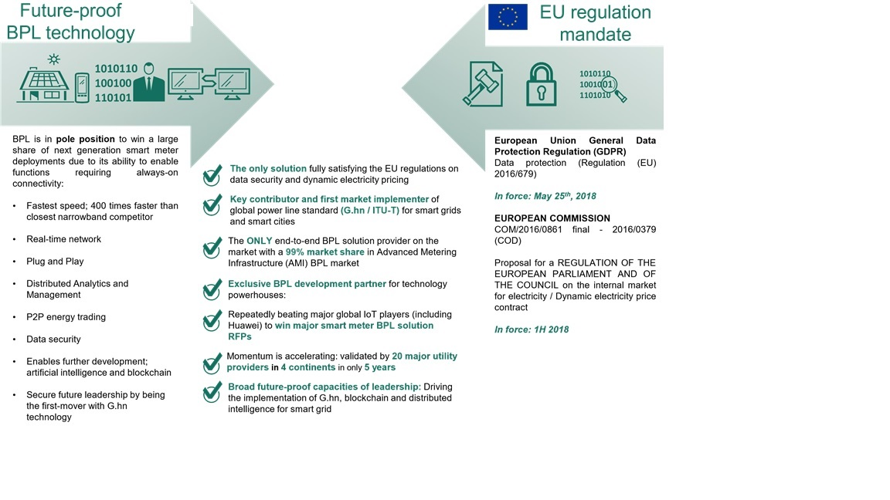
Example on:BB-PLC

Slide 47
Communication
Broadband PLC Advantage
Mbps
Net
Work
High Speed
MESH
Anti-interference
High Security
Two Way Communication

Slide 48
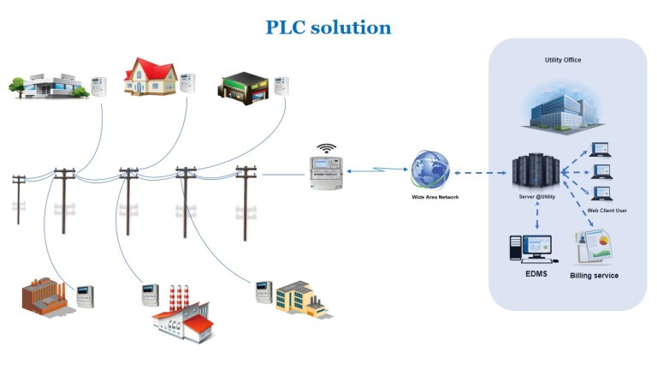
PLC- G3/Prime/BroadBand communication

Slide 49
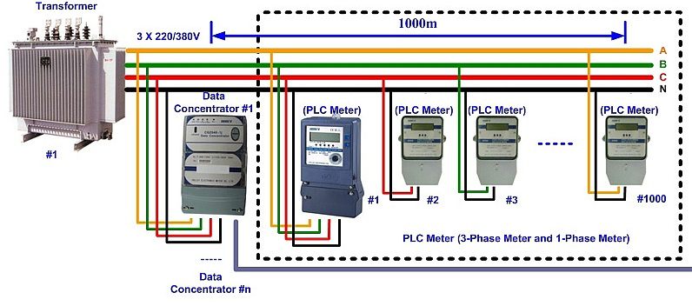
PLC- Communication

Slide 50
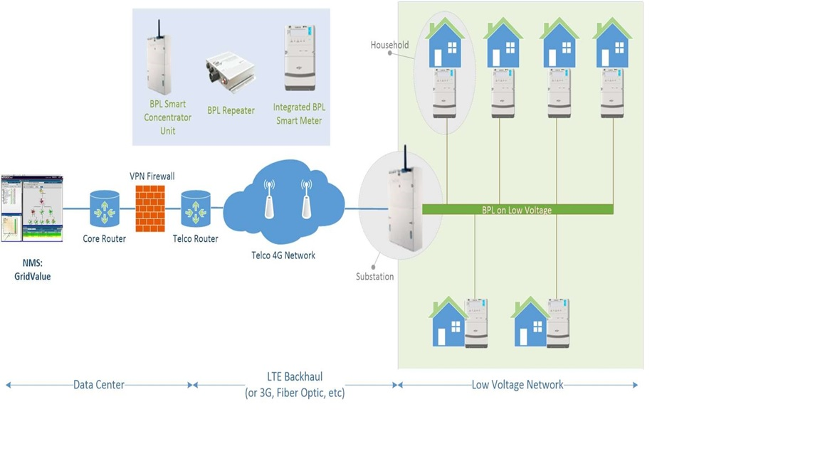
Example Solution Architecture:

Slide 51
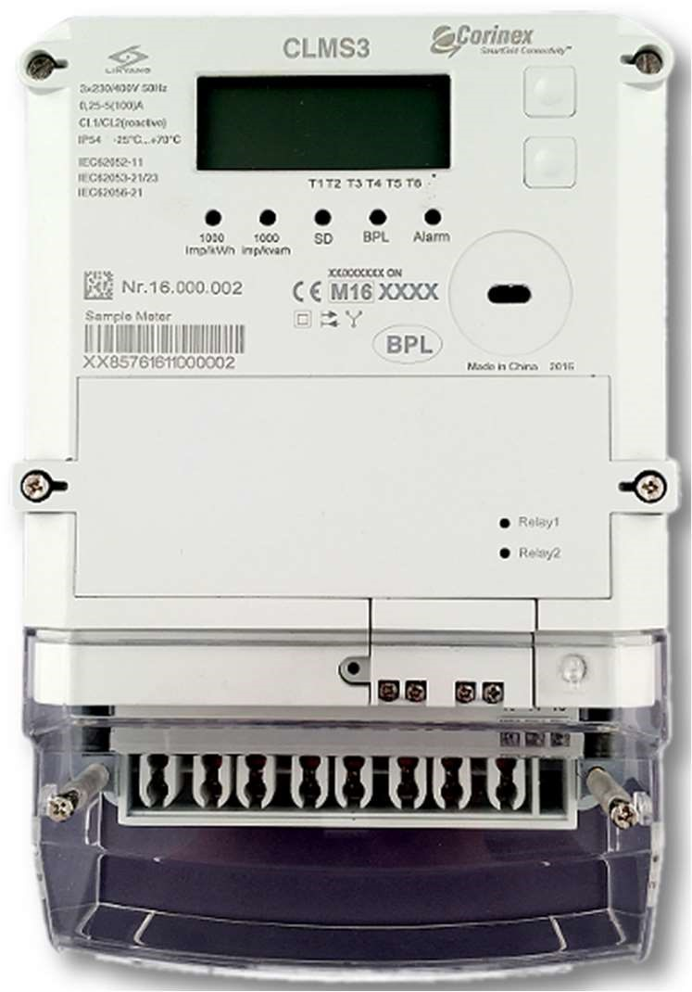
PLC Specific Features supporting Advanced Meter Infrastructure
Data Concentrator
PLC meter has IPV6 capability
Every meter has a broadcasting IP address
The meter is able to accept a broadcast message (e.g. a telegram for everybodyonly right ones react)
Reaction for part is OK
eg: change of tariff/output, change of virtual output, change of limiter, disconnect, etc.
telegram if address
Similar actions as above enabled in TOU
Above actions are enabled by unicast and single address command
A possibility to operate so called “Universal Relay – home load control ”
Our IP broadcasting enables selective disconnection of customers and ensure power supply to emergency facilities

Slide 52
Digital Subscriber Line (DSL)
DSL is another technology that can be used for smart metering applications. DSL makes use of the traditional telephone line for the data transmission. It provides a backhaul for the smart grid data from homes to the utilities. DSL is a reliable and also a low-cost solution, since the infrastructure exists in most cases. A disadvantage of the DSL technology is that its throughput depends on the distance of the subscriber from the serving company. Another issue that arises with DSL when applied in Smart Grid is the possibility that the end-users get to be involved in smart grid access. This could give rise to the installation cost or create functional problems. And this technology is being replaced with fiber optic.

Slide 53
Fiber Optic Communications
Fiber optics provide a high-capacity, high-speed data exchange transmission media that is widely used in backbone transmission networks. At present, the high installation costs associated to its deployment makes it only a suitable solution in situations where high data transmission rates are required.
In the utility industry this means that use of Fiber optic for direct communication to a meter is very limited and mostly used to connect concentrators to the back office when utilities own the fiber networks.

Slide 54
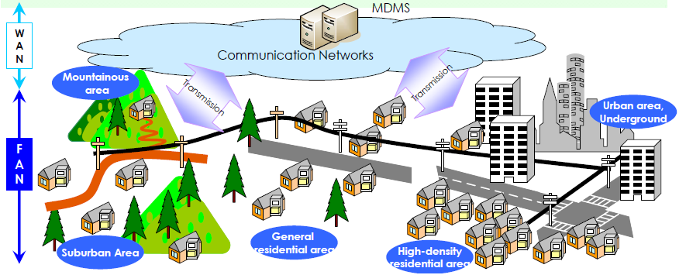
Smart Grid-Distribution Line- Fiber Optics

Slide 55
Suitability of Communication Module for Smart Metering – PLC (Both)
Advantages | Disadvantages
Ready infrastructure (power cables) Communications possible in challenging environments such as underground installations, metal-shielded cases etc. Relatively long technology lifecycle (v/s GPRS) Good option for new residential colonies and newly electrified villages with new electrical network designed and built for PLC applications Broadband PLC (BPL) can offer telephone and internet connections as well to customers | Requires good quality power cables with crimped joints (in Bangladesh mostly aluminium wires are have twisted joints which are not good for PLC) Requires filters to clean the communication signal (from noise) Communication not possible in case of power outage Requires trained manpower for O&M.

Slide 57
Communication
Common Integretion Area of PLC Technologies
PLC solution support G3, Broadband and PRIME
Features | G3 | Broadband | PRIME
Maximum Communication Distance | 0.6km | 0.7km | 0.2km
Baud Rate | 2.4k~33.4kbps | 2M~10Mbps | 43k~128.6kbps
Working Frequency Band | 30K~500khz | 2M~12Mhz | 30K~500khz
Network Relay Levels | 7 | 15 | 7
Single Time Reading | 5~10S | 0.4~0.8S | 5~10S

Slide 58
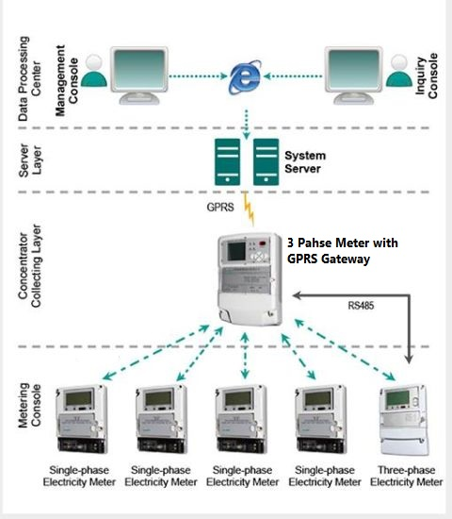
Rs-485 and gprs communication

Slide 66
Apart from the wired solutions described above, nowadays there are emerging technologies which would be suitable for the realization of the Internet of Things (IoT). Such technologies are suitable for the Low Power WAN (LPWAN), where transmissions of a few kb over large distances at low speeds in the most power-efficient way are required. Therefore, such a network could be suitable for smart metering applications. Three technologies designed for this scope are namely:
SigFox: Its concept is similar to cellular networks; however it is designed to offer services to devices. The transmission is Ultra Narrowband (UNB), while the 868 MHz band is used. There are 400 channels of 100 Hz. Due to the ultra-narrow bandwidth, the noise effect is very low, thus the system is able to recuperate a very low power received signal. LoRaWAN: It is a specification for Low Power Wide Area Networks and it operates in the 433, 868, 915 MHz band. The channel bandwidth is 125 kHz; the modulation used is either FSK or a chip spread spectrum modulation; the data rates that can be supported are from 0.3 kbps to 50 kbps.
NB-IoT: It is a narrowband radio technology designed for the IoT, which has been standardized by the Third-Generation Partnership Project (3GPP) body. It can be deployed in the GSM spectrum and it can support a big number of low throughput devices. NB-IoT is divided into cellular based and non-cellular based.

Slide 67
Wireless Technologies
Radio frequency (RF) and cellular technologies are the most common. When it comes to RF, there are point-to-point, point-to-multi point and mesh solutions.

Slide 68
Cellular Technologies—GPRS/3G/LTE
Usually, cellular technologies on smart metering applications are preferred for the telecommunication link between the meter or the data concentrator and the utility data center. One of these cellular technologies can be the GSM or GPRS. The frequency bands used in Europe are the 900 and the 1,800 MHz bands. GSM has also been considered for implementation for smart grid monitoring and controlling. The main advantage of GSM is that the network already exists, thus making it the simplest solution for utilities. On the other hand, the GSM network was not originally designed to carry smart metering data, but voice data, so the handling of the increased data traffic from smart meters along with existing voice data services could become an issue. In addition, the GSM/GPRS bands have been mostly allocated for existing mobile services; therefore, it is hard to get the available spectrum for developing a dedicated network for smart metering applications.
The 3G is the third generation of the mobile telecommunications technology. The data rate provided should be at least 0.2 Mbps. The two main standards considered to belong to the 3G category are the UMTS and the CDMA2000. Two more standards are the EVDO and the EDGE. The frequency band occupied is between 800 MHZ and 1900 MHz for CDMA and EVDO. In addition, the 450 MHz band can be used for CDMA applications. Referring to the smart metering applications, the 3G can be used as the communication link between the data concentrator and the utility data center. The advantage of this technology is that it is already deployed in a large scale, so it can be considered as mature and stable.
The Long Term Evolution (LTE) technology is a standard for high speed mobile communications. It is the evolution of the GSM/UMTS standards. With regard to the 3G architecture, it shows reduced latency. However, its wireless interface is incompatible with 2G and 3G networks. In addition, different bands are used in different countries meaning that devices compatible with one country’s regulations can be incompatible with another one’s. Referring to smart grid applications it can be used, like the other cellular technologies, for supporting the Advanced Metering Infrastructure backhaul network and in particular the communication link between the data concentrator and the utility control center. The main advantages of LTE technology is the low latency it offers, its high capacity and its low power consumption. On the contrary, the main problem is that the equipment cost remains high.
For smart metering, NB-LTE (Narrow Band LTE) is emerging as a reliable and feasible alternative for LTE.
Another important consideration for the use of cellular technologies in particular at this moment the 2G type networks is life cycles of these networks. For utilities the consideration for a specific technology includes the management and costs associated with replacement of the whole or parts of technology. For metering, visiting a site and having to replace the communication technology forms an important decision factor. Due to this reason utilities are now requiring bidders to work with operators and obtain guarantees the technologies will be in operation for period of time in excess of between 10 - 15 years.

Slide 69
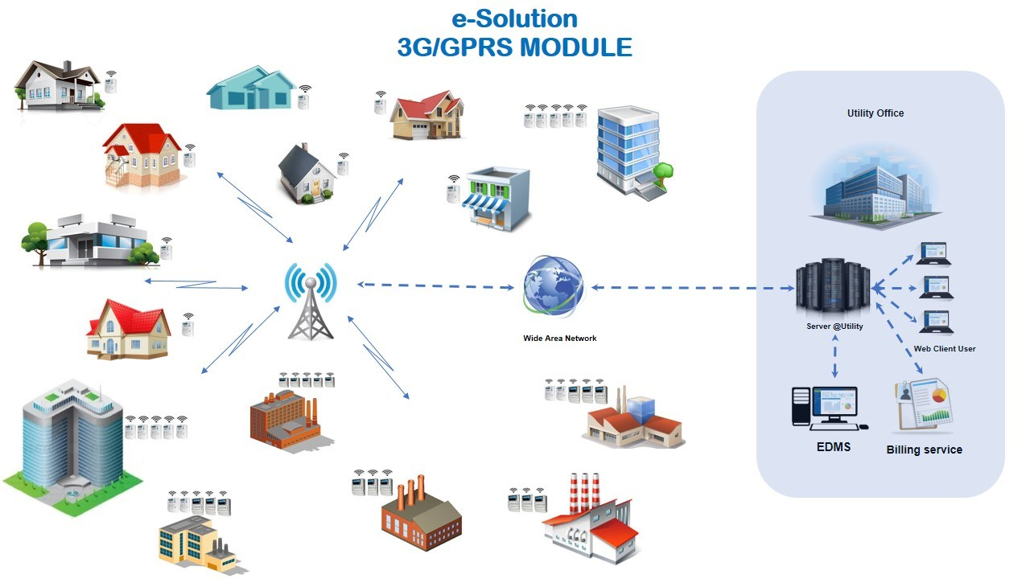
GPRS Communication

Slide 70
Suitability of Communication Module for Smart Metering – Cellular- GPRS
Advantages | Disadvantages
Mature technology Rapid deployment Communication modules are low cost and standardized Best solution to get meter readings automatically from select set of customers scattered over a large geographical area | Limited coverage (data network is poor in villages) Short technology lifecycle (2G => EDGE => 3G => LTE =>4G Limited scalability and spectrum High operating cost - monthly recurring cost to cellular operators per SIM card Most benefits of AMI cannot be achieved except meter reads

Slide 71
WiMAX
WiMAX is a wireless communication standard that can provide with a data rate up to 75 Mbps. It can be considered as an alternative technology for delivering fixed wireless broadband access. It refers to the family of IEEE 802.16 standards for wireless-networks and it can be used as a backup technology for cellular phone technologies like GSM and CDMA. With respect to the smart grid applications, it can be a suitable candidate for connecting the data concentrator with the utility’s control center. This technology can be a suitable solution for utilities, since it implies low implementation costs, a lower degree of complexity and with an effective control over possible applications. Despite the advantages that it has to offer, the fact that the bandwidth of WiMAX needs to be shared among users remains an issue.

Slide 72
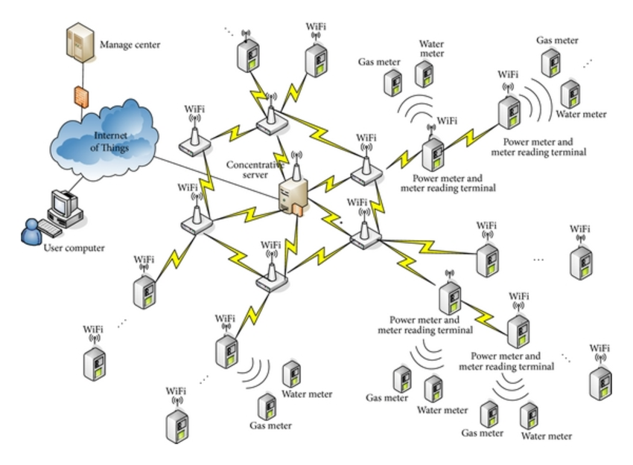
WIFI-MESH

Slide 73
ZigBee
A wireless technology that is widely used in smart meter applications is ZigBee, which has its physical and MAC layers based on the IEEE 802.15.4 standard. Similarly to the NBPLC, when it comes to smart meters, it is usually preferred for the telecommunication link between the smart meter and the data concentrator rather than the link between the data concentrator and the control center. It operates in the 2.4 GHz band (worldwide) and its range is between 10 and 100 m, depending on the output power and the environmental conditions.
It is suitable for applications with low data rates and low power consumption and it is appropriate for wireless control and monitoring applications. Some typical applications include building automation, home automation, wireless sensor networks, smart lighting, Advanced Meter Reading (AMR), etc. ZigBee entails a low cost of deployment as well as low complexity. Regarding the AMR applications, one of the advantages of Smart meters, into which the ZigBee protocol is embedded, is that they can easily communicate with smart in-home devices, like smart appliances and home displays. On the other hand, ZigBee experiences a high interference ratio from other applications that use the same bandwidth, which could cause system degradation.
The ZigBee protocol can be also chosen for building a wireless mesh. This is a communication network made up of radio nodes in a mesh topology. The nodes can be all connected to each other, leading to a fully meshed topology or partially connected, leading to a partially meshed topology. The concept of a meshed network indicates that when a node fails, then the information data can be forwarded through an alternative path to the destination. Every smart meter in a mesh network is considered as a node and data is routed through them.

Slide 74
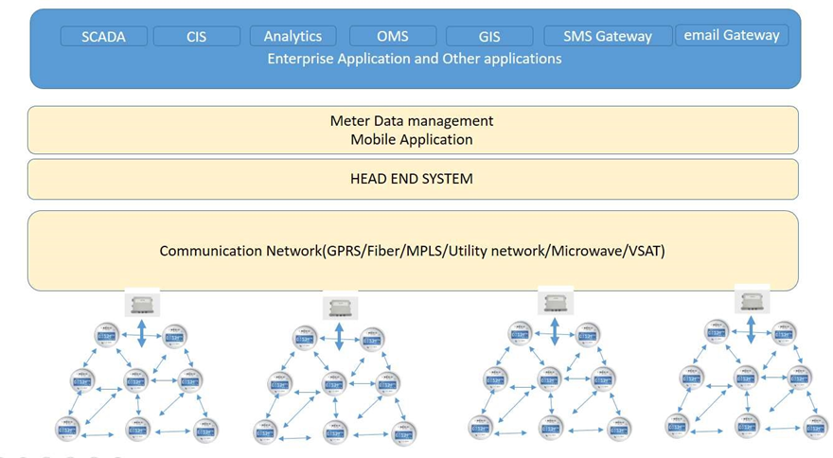
RF mesh network technology solution

Slide 75

RF-Mesh Communication

Slide 76

RF-Mesh Communication

Slide 77
RF Mesh Requirements
General
RF mesh equipment shall be Wi-SUN FAN product certified for FCC band. If not certified yet, certification shall be submitted before 2 (two) weeks of Factory Acceptance Test. Platform certificate is not acceptable.
The frequency shall be 866-868 MHz or 922-925 MHz.
Output power shall be from 500 mW to 1 W.
It shall support two-way communication.
It shall support over the air firmware upgrade.
It shall support time synchronization.
It shall support DTLS.
Communication module for smart meter
It shall be field replaceable.
It shall be plug-and-play.
Minimum date rate shall be 50 kbps.
It shall support auto registration.
It shall support auto routing.
It shall be powered by meter itself.
It should be possible to retrieve mesh topology.
It should be possible to communicate with the meters directly using DLMS/COSEM and CoAP.
It should be possible both to unicast (upgrade one meter node) and multicast (upgrade a group of meter nodes simultaneously) using software and common configurations.
It shall have a built-in antenna so that a separate external antenna is not necessary.
It shall support “last gasp”.

Slide 78
Repeater/Relay
It shall be possible to install/replace/remove without special tools.
It shall be able to be installed at power poll as well as on wall.
It shall be possible to install external/extension antenna for neighbor area network.
It shall support IP65. Use of external enclosure that meets the IP degree is acceptable. In the latter case, the dimension shall be less than 400 x 300 x 150 (H x W x D, in mm).
It shall support “last gasp” and outage notification, and shall be operate at least 4 hours during power outage for communication with data concentrator.
Data Concentrator/Access Point/Gateway
It shall be able to be installed at power poll as well as on wall.
It shall be possible to install external/extension antennas for neighbor area network and backhaul network.
It shall support IP65. Use of external enclosure that meets the IP degree is acceptable. In the latter case, the dimension shall be less than 600 x 400 x 150 (H x W x D, in mm).
It shall support auto discovery of smart meters.
It shall be able to support at least 500 meters.
It shall support over the air firmware upgrade of the equipment itself as well as smart meter, communication module and repeater/relay.
It shall support “last gasp” and outage notification, and shall be operate at least 8 hours during power outage.
It shall support SNMP v2 and web server.
It shall provide network topology for connected meters.
It shall support signal level for connected meters.
It shall support IPSec VPN.

Slide 79
Suitability of Communication Module for Smart Metering – RF Mesh
Advantages | Disadvantage
Scalable (only DCUs/Gateways are needed) Negligible operating cost Can be used in multiple frequency bands Relatively long technology lifecycle (v/s GPRS) Other electrical network elements such as DT monitoring devices, street light controllers, RTU/FRTUs for distribution automation etc. can also be connected to the same RF Mesh network Best solution as of now for deriving most benefits of AMI such as: outage detection and faster restoration. | Initial cost of building the RF mesh network high Trained engineers required to setup the RF Mesh network Communications problems: meter installation in underground & metal-shielded box.

Slide 80
About One wireless example –RF MESH
The Detail on RF is

Slide 81

Smart Grid Communication Technologies. Technical Comparison

Slide 82


Slide 83
Regulation on Radio Frequency in Bangladesh
Frequency allocation and regulation is the responsibility of Bangladesh Telecommunication Regulatory Commission (BTRC).

Slide 84
Use Free Radio Frequency (RF) for Smart Meter
Bangladesh Telecommunication Regulatory Commission (BTRC)

Slide 86
National Table of Frequency Allocations (NTFA)
NTFA provides National Table of frequency allocations and major usages with entries of relevant frequency plans. Considering smart metering/AMI, unlicensed frequency is the best interest.
The table below summarizes suitable frequency found from Table of Frequency Allocations, Edition of 2018.
No. | National Allocation | Usage
1 | 758-890 MHz (CIVIL) | 6. Non-specific SRD in 863 – 876 MHz
2 | 890-942 MHz (CIVIL) | 3. Non-specific SRD in 915 – 921 MHz
3 | 2 400-2 450 MHz (CIVIL) 2 450-2 483.5 MHz (CIVIL) | 1. ISM applications in 2400 – 2500 MHz 3. Non-specific SRD devices in the band 2400 – 2483.5 MHz
4 | 5 725-5 830 MHz (SHRD) | 1. Point to point and point to multipoint systems in the band 5 670-5 850 MHz 5. CT; Tracking, Tracing and Data Acquisition; Transport and Traffic Telematics (TTT), detecting movement and alert and Nonspecific SRD devices
5 | 5 830-5 850 MHz (SHRD) | 1. Point to point and point to multipoint systems in the band 5 670-5 850 MHz 4. CT; Tracking, Tracing and Data Acquisition; detecting movement and alert and Nonspecific SRD devices
6 | 5 850-5 925 MHz (SHRD) | 3. Tracking, Tracing and Data Acquisition; detecting movement and alert and Nonspecific SRD devices

Slide 87
Frequency Allocation for IoT
In addition, Instructions on IoT Devices Importation in Bangladesh, dated April 2018, specifies that:
Frequency & Output Power of IoT Device
IoT devices are SIM Based or Non SIM Based Sensor Device. Such Sensor use mobile operator network to collect data or SRD (short Range Device), ISM (Industrial, Scientific & Medical) weave length. For the use of Non SIM Based IOT device following frequency are allocated considering National Frequency allocation plan (NFAP):
433.05 - 434.79 MHz
866 - 868 MHz
922 - 925 MHz
2400 - 2483.5 MHz
5725 - 5875 MHz
For the increase of Use IoT device above frequency will be considered in future. The Maximum power output of IoT device will be 1 - 2 Watt/30 - 33.01 dBm.
Consequently, it would be more beneficial for distribution operators to select frequency from above five bands, especially sub-giga bands.
Unknown Details of the Regulation
Frequency allocation for non-cellular IoT is specified by BTRC, however, details such as Spectrum access and mitigation requirements (ex. duty cycle and adaptive power control), Modulation / maximum occupied bandwidth (ex. <= 50 kHz, <= 200 kHz, 1 MHz <= <= 20 MHz), and applicable standard (ex. EN 300 220) are not specified.
So, developers for the SRD solutions will contact BTRC to get clarification about details of regulation.

Slide 88

Technology Comparison

Slide 89
Telecommunication Technologies: Multi-Criteria Analysis side-by-side around the Globe
Technology | Avantages | Drawbacks | References
PLC low speed (Prime / G3-PLC) | Cost, Standard, Private network | Noise & harmonics on the LV Network (industrial Customers) | PRIME: ~15 millions Spain, Portugal, Poland,… G3: ~5 millions France, Belgium, RSA, Austria
PLC high speed ( PLC IOT) | Cost, Speed, Private network | Standardization in progress, fading over Underground networks | ~20 millions China
Radio (RF Mesh, P2MP) | Coverage, speed, Private network | Cost, Interference, Local Regulations | USA, CANADA
GPRS/3G | coverage, speed, Easy to deploy | Cost, dependence on the operator, Congestion | England

Slide 90
Technology | PROS | CONS | Cost Factor
PLC | It’s cost effective. Powerline communication can transmit over long distances. In North America, this can be a cost-effective advantage for utilities serving rural communities. Because it is a hard-wired system, topographical and other physical obstacles do not affect performance. It leverages existing investments. Because PLC utilizes existing infrastructure, the utility owns the communications system and there may not be as much of a learning curve involved with implementing this type of communication method. It returns data useful in analyzing grid performance. This system uses the distribution network to send signals from the meter to the substation. Signal strength provides the utility with analytics that can help isolate and troubleshoot problems with insulators, transformers, and other grid devices. | Potential for network interference. Utilities with large industrial customers that may introduce noise and harmonics on the power line have found that this noise on the system may affect performance and distort communications. Less bandwidth. Narrower available bandwidth can impact data capacity and the speed or rate at which data can be accessed in some applications. | • Meter: - Comm. module • DCU: DCU itself SIM card Data cost In addition, the following can be a cost factor: • Repeater: Repeater itself Installation • Noise filter

Slide 91
POINT- TO MULTIPOINT (Wireless) | less infrastructure. One tower to cover a large geographic territory. raise no interference issues since it is a licensed network with network communications. It’s easy to deploy. Since the network may be deployed from a few towers, | 1.Challenges of securing tower space. 2.Require installation or leasing of a tower. 3.Result in transmission congestion. 4.The more meters and devices communicating to a single point, the more likely network congestion and bandwidth limitations are. 5.It’s not self-healing or self-routing. Unlike an RF mesh system. 6.if the base station goes down, communication to thousands of meters may be lost. 7.It requires licensing. Along with a fee, a limited bandwidth is associated with each license. In addition, a second license may be required for distribution automation functions or other advanced grid management applications. The internal labor required to manage and maintain these licenses is also a consideration. | • *Meter: - Comm. module • Collector :Collector itself and Data cost Tower for collector • Antenna: Antenna itself and installation

Slide 92
RF MESH (Wireless) | RF mesh technology can be regionally distributed, so the operator can target specific areas without needing to deploy the entire service territory. It’s self-healing. If one module loses communication with the network, the network automatically finds another path to bring communications back to the head-end system. So, the network operator never needs to worry about the entire network being down. It’s self-forming. The network’s intelligence enables the signal to find the optimal route back to the head-end system. This is particularly important in areas with | RF mesh technology may require more infrastructure than other options, especially in rural areas where meters are more spread out across the service territory. It may raise interference concerns. Unlicensed frequencies used in RF mesh may raise some concerns about interference. Some countries restrict use of frequencies in the unlicensed spectrum, including RF mesh. | • Meter: - Comm. module • DCU: DCU itself SIM card Data cost In addition, the following can be a cost factor: • Repeater: Repeater itself Installation • Antenna: Antenna itself Installation
 | many obstructions, such as mountains or high-rise buildings.

Slide 93
Note: Wireless technology is highly subject to regulations.
CELLULAR WIRELESS | Faster deployments. Cellular enables longrange communication and can be rolled out quickly using the existing cellular infrastructure. It leverages an existing network maintained by the cellular company. In most utility service territories, cellular already reaches the majority of customers. It’s optimal for targeted applications. Cellular can be deployed cost effectively to support small groups of customers, even a single customer. It’s proven technology. In use for more than a decade, cellular technologies are well established and reliable and are continually improved upon — particularly as it relates to security. It’s secure. Because they already provide service to billions of customers worldwide, cellular networks extend the promise of safety and performance to utilities. | It may require head-end system changes. In the North American market, most of the widely deployed head-end systems are optimized for either RF (mesh or point-to-point), PLC, or a combination of these. Incorporating a communications technology less-widely for AMI purposes, such as cellular, may require modifications to the head-end solution. It has obsolescence issues. Cellular networks tend to roll over prior to the useful life of the metering technology, so many operators are concerned about how long a deployed technology will remain viable. It’s a network availability issue. The missioncritical communications that smart grid networks require need nearly 100% network availability. When utilities share public cellular networks, they are often at the mercy of the carrier’s priorities in the event of an outage. It can be unreliable. If a natural disaster impacts the cellular infrastructure, networks may become overburdened. Cost for SIM card and data comm. for each meter has high economic impact on CAPEX and OPEX. | • Meter: Comm. module SIM card Data cost In addition, the following can be a cost factor: • Antenna: Antenna itself Installation • Gap filler: Gap filler itself Installation * Only possible for MNO

Slide 94
Difference between NB-PLC(G3PLC) and BB-PLC
Items | G3 -PLC | Broad band PLC(BPL)
PHY | OFDM | OFDM
Working frequency band | 30~480KHZ | 2M~12M
Security | MAC layer and application layer are using encryption | N
Interconnectivity | Y | N
The international test standard | Y | N
Static power | 0.25W | 0.6W
TCP/IP | IPV6 | IPV4
Remote upgrade | Y | Y
The cost of the module | Low | high

Slide 95
With respect to AMI + Smart Meter CommunicationTechnology Comparison
Positives
Negatives
Parameter | Cellular (3G/4G/LTE) | RF Mesh | PLC
Spectrum Type | Licensed | Unlicensed/Licensed | Unlicensed
Typical Data Rate | 1 -2 Mbps | 9.6 –100+ Kbps | Several to 100+ Kbps
Latency Rate | < 1 sec | 1 –60 sec | < 1 sec
Coverage | Wider Coverage | • Up to 50m. • Can be enhanced with topology selection | • Up to several Kms. • Data rate decreases with distance
Reliability | Rate of successful link establishment > 99% | Deployment & product specific | Dependent on underlying power line
Capital Cost | Less CAPEX | Relatively High CAPEX | Moderate CAPEX
Operating Cost | Relatively High OPEX | Low OPEX | Low OPEX
Security | Relatively more secure | Relatively less secure | Relatively less secure
Vendor Dependence | Continued dependence | Low dependence | Low dependence
Obsolescence Risk | High | Low | Low
Leverage for SmartGrid/ DER/Smart City | NO | Yes | NO
Deployment Model Suitability | All | Area Wise Deployment | Feeder/Transformer Wise Deployment
Utilities will need to determine the best network for their particular requirements.

Slide 96





Different Network Domain in AMI and Smart Grid
Domain 1
Smart Meters
Domain 2
Communication
Domain 3
MDMS & Associated Applications
N
I
C
F
A
N
Data Collector
W
A
N
H
E
S
M
D
M
S
Customer
Portal
Consumer
Meters
Outage Management System
Street Light
Meters
N
I
C
Billing (Prepaid & Postpaid) and
Energy Auditing
EV Charging
Meters
N
I
C
Demand
Response
Mobile Workforce
Management
Distribution
Transformer
Meters
N
I
C
NIC – Network Interface Card
FAN – Field Area Network
WAN – Wide Area Network
HES – Head End System
MDMS – Meter Data Management System
Other Utility
Applications
Distribution
Automation
RTU/FRTU
N
I
C
Distribution
Management
System

Slide 97
Communication Technology in Different Layer of AMI and Smart Grid
Technology / protocol | Home Area Network (HAN) | Last mile/ NAN/FAN | Wide Area Network (WAN) / Backhaul
Wireless | RF mesh ZigBee Wi-Fi Bluetooth NFC | RF mesh ZigBee Wi-Fi | Cellular/GPRS Satellite Private Microwave Radio
Wired | PLC Ethernet Serial interfaces (RS-232, RS-485) | PLC Ethernet Serial interfaces (RS-232, RS-485) DSL | Optical Fiber Ethernet PLC DSL

Slide 98
3GPP | Third-Generation Partnership Project
AAA | Authentication, Authorization, Auditing
AES | Advanced Encryption Standard)
AMI | Advanced Metering Infrastructure
AMM | Advanced Meter Management
AMR | Automatic Metering Reading
ARIB | Association of Radio Industries and Businesses
BB-PLC | Broad Band PLC
BPLC | Broad Band PLC
BPSK | Binary Phase-Shift Keying
BTRC | Bangladesh Telecommunication Regulatory Commission
CAPEX | Capital Expenditure
CDMA | Code Division Multiple Access
CENELEC | European Committee for Electrotechnical Standardization
CoAP | Constrained Application Protocol
COSEM | Companion Specification for Energy Metering
CPE | Customer Premises Equipment
DA | Distribution Automation
DCU | Data Concentrator Unit
Abbreviation
The following abbreviations are used in this report.

Slide 99


AMI (Advance Metering Infrastructure)

Slide 100

Presented By
Engr. Md. Kausar Ameer Ali
Managing Director
Dhaka Electric Supply Company Limited
(DESCO)

Slide 101
Unified Prepayment System
At present, 5 utilities, including DESCO, have prepaid metering
systems with similar standards. Under the prepaid metering system,
meter vending system including CDC, MIC, POS has been developed.
This system does not have an Application Program Interface (API) for
communication with Head End System (HES),
Meter Data Management (MDM) and various Devices (Meter, DCU, Server).
This system has some limitation which are:
Token insert manually.
Only prepayment vending is doing.
Vending data is preserved, no meter data is storing in the system.
Online meter monitoring/control is not possible

Slide 102
Unified Prepayment System (Cont.)
We need to launch Smart Metering System according to the current demand. The following issues need to be included in the current Unified Prepaid Metering System:
Standard Head End System (HES).
AMI/MDM System.
Standard API for different Device (Meter, CDU, Server) development.
Software up-gradation for integrating the whole developed software and interface.

Slide 103

Existing Unified Prepayment System Architecture

Slide 104
AMI Overview
AMI (Advanced Metering Infrastructure) enables the application of technologies, such as smart meters and other advanced metering devices, to enable a two-way flow of information between customers and utility and to provide customers and utility with data on consumption including time and amount of consumed energy and electricity price.

Slide 105

AMI Overview

Slide 106



Smart Meter Operation
• Remote Connect/Disconnect
• System based prepayment
• Load Control
Advanced Features
Communication
• Bi-directional communication
• NIC : RF Mesh IP
• Supports Firmware Upgrade
Technology
• IEC 62053-21, DLMS
• Energy & Demand Measurement
• Load Profile
• Data Memory
• Monthly History Data
Measurement

Slide 107
Technology Comparison
MOST SUITABLE TO IMPLEMENT
Adverse to favorable- Project Success factors

Slide 108














Solution Architecture
FAN
WAN
Enterprise Applications
Router
Network
Gateway
Backhaul
Network
Gateway
SEW
A/c Bill Agent’s
Dashboard Presentment Portal Present
Analysis Payments Utility Portal ation
Layer
OU C2M
Device
Customer A/c MR Mgmt. Management
Manager Manager ^{Rates} _{Determinants}
Pre-paid Billing Events & Alerts
Payments
OU SGG
Users
Reporting Layer
Usage
Application Layer Customers
H E S ^{CIS} Management
Network Device VEE & Bill Agents
_{(Recharge)} Energy Audit
DESCO
Bill Printing Letters ^{Transaction}
AMI

Slide 109











Solution Architecture
Interfaces
Agent’s Portal
Banks
OMS
A/c Dashboard
Bill Presentment
Usage Analysis
Payments
Utility Portal
SOA Integration Layer
Payment Gateway
SMS GW
Customers
OU C2M (Example : )
SCADA
ERP
CIS
Device Management
Customer A/c Mgmt.
MR Management
Agents
Rates
VEE & Bill Determinants
AMI Infrastructure
Pre-paid Billing
Events & Alerts
Payments (Recharge)
Energy Audit
AMI / AMR
DESCO Users
OU SGG ( Example: )
AMI / AMR
Reporting Layer
LG HES
AMI / AMR
Bill Printing
Letters
Transaction Reports

Slide 110









Smart Meters, Communication Networks and Software as Service
Smart meters
Communication networks
Software & Services
for data aggregation and management
Residential
Commercial
Network gateway
Head-end systems
Meter data
analytics
etwork route
Industrial
N r
Meter data management
Smart meters installed and connected intelligent devices

Slide 111



RF
Mesh – E35C Card
RF NIC
Modular Meter Communications
Communications NIC
◼
Plug and work, field-replaceable, electrician-free field
installation
Tamper Alarms
Scalable push data architecture
Facilitates over-the-air radio firmware and meter firmware
upgrades
Prioritizes messages for power outage and restoration
notifications
Last Gasp & First breath notifications supported
Real time event notifications
Efficient internal antenna to reduce costs
◼
◼
◼
◼
◼
◼
◼
15

Slide 112


RF
Mesh – Network Gateway
Network
Gateway
Communications Gateway
◼
◼
◼
◼
◼
◼
◼
◼
◼
Latest Generation Network Equipment
Configurable and Scalable
Environmentally Rugged
Tamper Alarms
Multiple Mounting Options
Battery Backed – 8 hours
GPS
Secure WiFi for Configuration
Linux Processing Module
Next Generation Gate
way
Communications
◼
◼
LTE and Ethernet Backhaul with failover
Supports from 1000 to 5000 end points (as per variant)
16

Slide 113


RF
Mesh – Router
Network
Router
Provides additional connectivity
Communications Gateway
◼
◼
◼
◼
◼
◼
Configurable and Scalable
Environmentally Rugged
Tamper Alarms
Multiple Mounting Options
Battery Backed – up to 8 hours
Linux Processing Module
Communications
◼
◼
Acts as fast-lane to gateways for network traffic
Supports up to 1500 endpoints
17

Slide 114

Smart – metering RF Technology at work
Smart Meters
Smart Network(backhaul)
Best option to be chosen)
Smart Backend Servers
Analytics :
Load Forecasting
PLM
Revenue Protection
Tamper Analysis
Outage Co-relation
Energy Accounting
AT&C Loss
Prepay

Slide 115
Thanking You.

